Slide 1

Image Generation using GAN’s

Slide 2
Deep
Learning
Computer Vision

Slide 3
Market Value CV
01
02
Health
Production
03
04
Retail
Content Here

Slide 4
ARTIFICIAL
INTELLIGENCE
MRI Brain Scan

Slide 5
Overview of GAN Structure
Generator
Discriminator
The generator learns to generate plausible data. The generated instances become negative training examples for the discriminator.
The discriminator learns to distinguish the generator's fake data from real data. The discriminator penalizes the generator for producing implausible results.

Slide 6
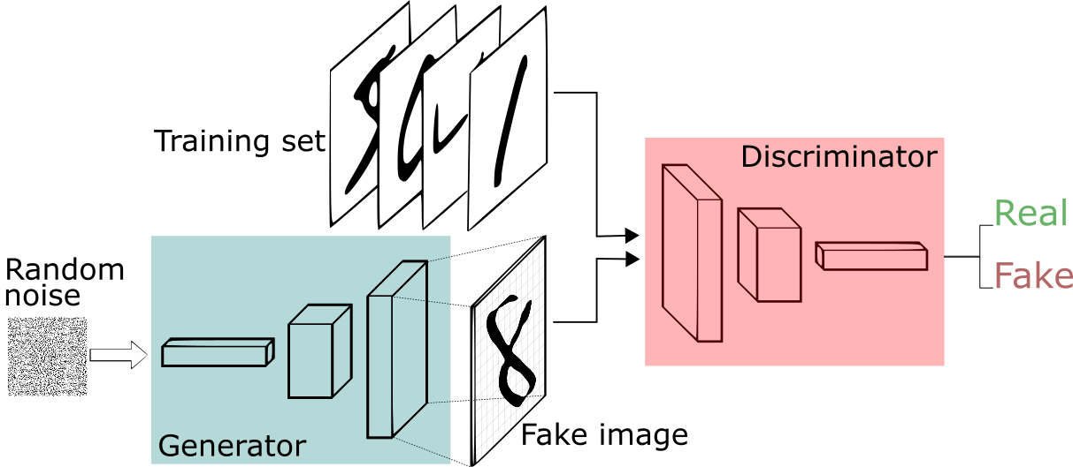
BASIC LAYOUT

Slide 7
Project Flow
Dataset
Discriminator
http://www.cs.toronto.edu/~kriz/cifar.html
The discriminator's training data comes from two sources:
Real data instances, such as real pictures of people. The discriminator uses these instances as positive examples during training.
Fake data instances created by the generator. The discriminator uses these instances as negative examples during training.
Generator
The generator part of a GAN learns to create fake data by incorporating feedback from the discriminator. It learns to make the discriminator classify its output as real.
Testing Model
After completing the training it’s the time for testing the model.

Slide 8
Let’s Check the Samples

Slide 9
ThisPersonDoesNotExist?

Slide 10
Thank You

